Slide 1












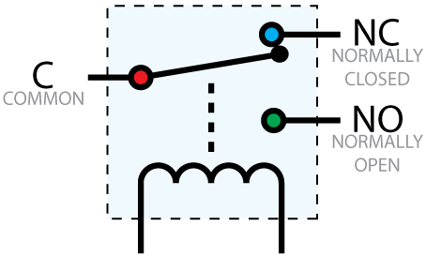











Limitations of today’s AAC switches
The SensAct AAC switch solution
Costly
A variety of sensors: touch, light, sound, joystick, accelerometers, gyroscopes
Plug and play to find best fit
Sensitivity tuned to individual users
Pre-configured profiles with proven use cases e.g one-touch mouse control, joystick mouse
Easily customized to suit special needs
Usually not customizable
Do one thing only
Intro
Multi-modal
SensAct
Functions as a computer mouse, keyboard
Functions as an infra-red remote for TV
Functions as a Tash switch e.g. to activate call bell
Bluetooth enables interaction with smartphone, tablet
A project from Bruyere Continuing Care
Fully Open Source https://github.com/AbilitySpectrum/Sensact
Currently in trial – looking for testers
Qualified users and OT/SLP/AT, please apply:
Bocar N’Diaye bndiaye@bruyere.org
Support: abilityspectrum@gmx.com
Compatible with common OS’s and devices

Slide 2
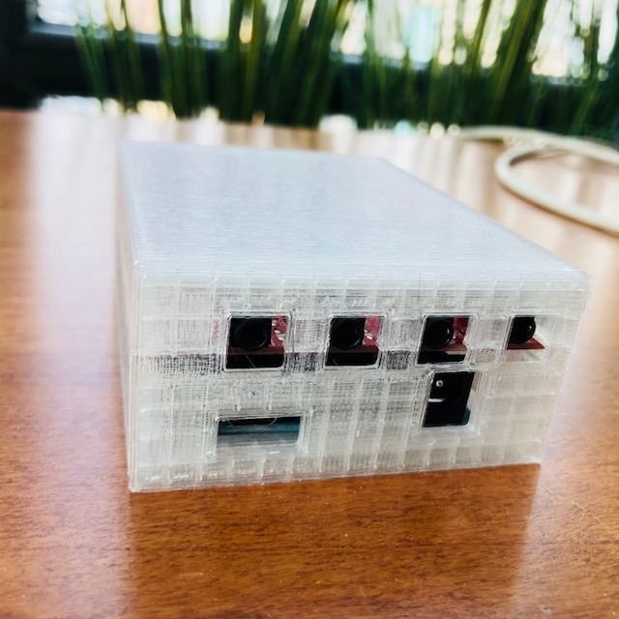
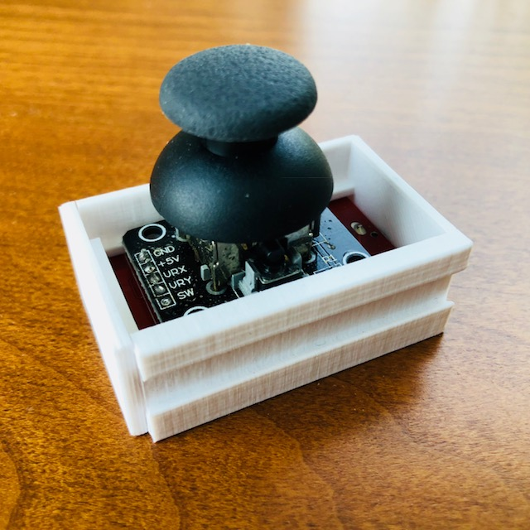
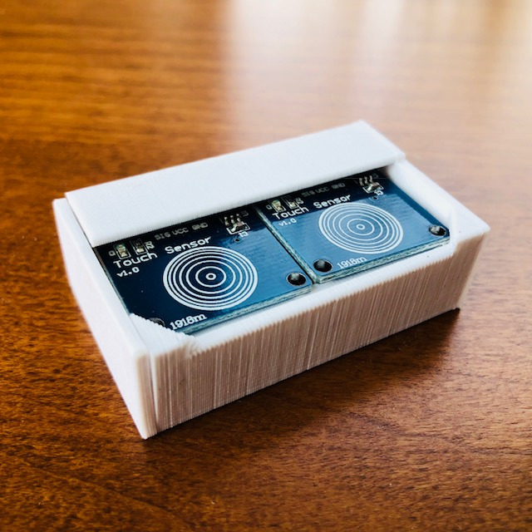
1 Connect sensors to SensAct
2 Connect SensAct to computer
Joystick (to 2)
Connect USB cable to any computer
(Optionally) connect A or B to any Tash device, using standard Tash cable
Dual-button Touch Sensor (to 1)
3 Play
Motion Sensor (to *)
Use the joystick as mouse. You may need to re-orient the joystick
Try the two buttons. They also move the mouse
Try to shake the Motion Sensor. Gently and you will hear a tone. Pause. Shake harder and you will hear a different tone. If you have the Tash output A connected to another device, Motion Sensor also activates that device.
Demo Quick Start
Use only 4-conductor 3.5mm cables for all sensors
Use only 2-conductor Tash cables on outputs A and B
Connect analog (joystick and touch) sensors to input 1,2 or 3 only.
Connect I2C (motion) sensors to input «*» only.
- See «SensAct User Documentation» for details.
Note!
SensAct
A project from Bruyere Continuing Care
Fully Open Source https://github.com/AbilitySpectrum/Sensact
Currently in trial – looking for testers
Qualified users and OT/SLP/AT, please apply:
Bocar N’Diaye bndiaye@bruyere.org
Support: abilityspectrum@gmx.com
What next?
There are many possibilities.
You can adjust the sensitivies of (some of) the sensors to suit the user’s preference.
You can load a different profile to change the way the user interacts with SensAct. We have many user-proven profiles.
Finally, you could use our software to custom make a profile to work exactly the way you’d like SensAct to work.
To do any of the above, see «Config Quick Start» or, for a definitive guide, «SensAct User Documentation». To find out more about the capabilities, see our «Intro» sheet.

Slide 3
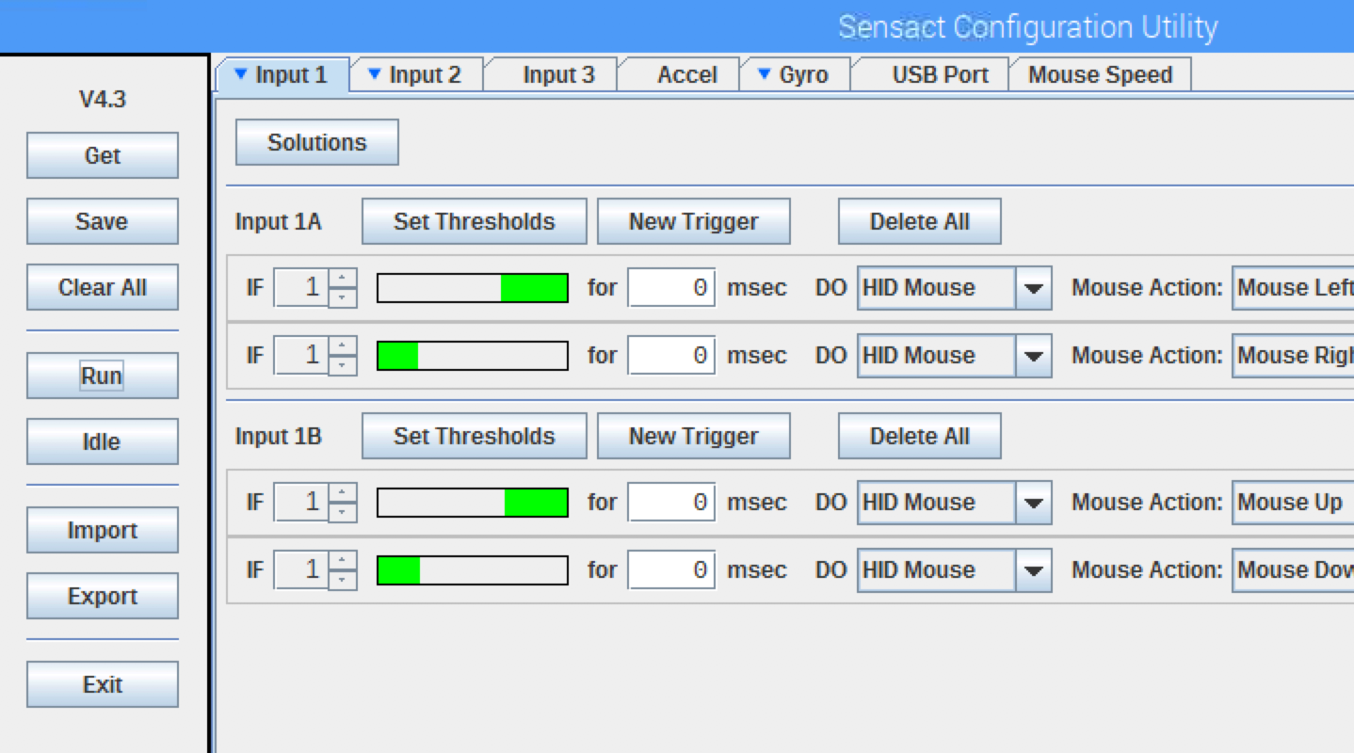
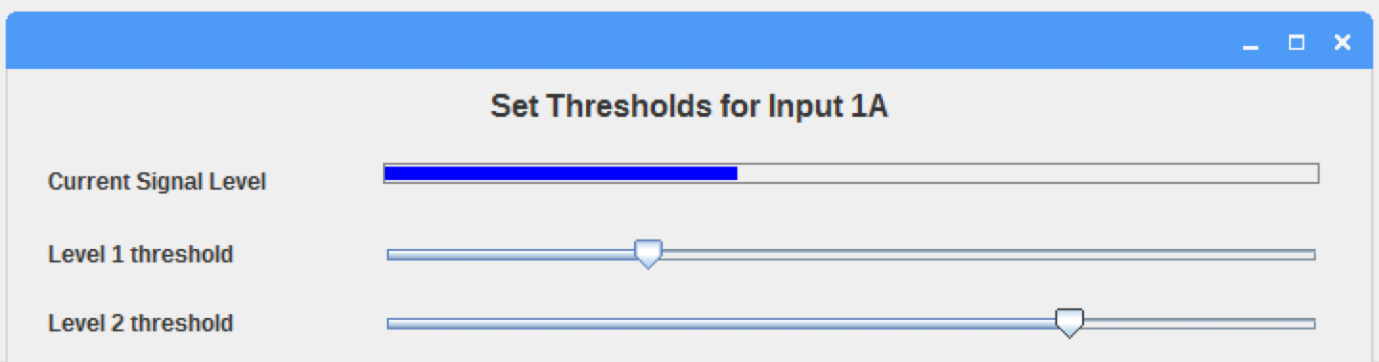
1 Install Configuration software
3 Adjust sensitivity
Make sure you have Java run-time 1.8 or higher. ‘
Check using this command « java –version’». You should see 1.8.xxxx
If needed, download from http://java.com/downloads
Copy « SensactConfig » to your computer’s local directory of your choice. You run the software from that directory
Cli ck to select which sensor port to configure
Then click ‘Set threshold’ for that sensor. Note that there could be several sensors on each input port
Menu
Commands on the side bar
Get - retrieve SensAct’s current configuration/profiles
Save – transfer the configuration to Sensact
Clear All – clear all configuration/profiles
Run - cause SensAct to run
Idle – stop SensAct from running
Import – import configuration from a file
Export – export current configuration to a file for reuse
Exit – exit the program
2 Run software
On Windows
Double-click on the « SensactConfig.bat « file.
On Macintosh
Double-click on the « SensactConfig.jar » file.
On Linux (Raspberry Pi)
Double-click on the « SensactConfig.run » file.
Config Quick Start
3. On the pop-up Set Thresholds window, you will see the current reading. As you activate/deactivate the sensor, the reading will change.
4. You can adjust the two different levels by moving the sliders. They determine the sensitivity of SensAct, as suited to the user.
5. Click Save on the sidebar to transfer the configuration to Sensact
6. Click Run to test the new configuration.
7. Click Idle to stop Sensact from running and re-adjust the threshold.
SensAct
A project from Bruyere Continuing Care
Fully Open Source https://github.com/AbilitySpectrum/Sensact
Currently in trial – looking for testers
Qualified users and OT/SLP/AT, please apply:
Bocar N’Diaye bndiaye@bruyere.org
Support: abilityspectrum@gmx.com
4 Try a different Solution
First select the sensor you want to work with
Then click the Solutions button and you will be presented with several Profiles
Select a profile that seems suitable to the sensor. I.e. pick a «button » profile to go with a button or touch sensor. Or, pick a joystick profile to pair with a joystick
Click Save and test the new profile
Click Idle any time to re-start the process. Either adjust the sensitivity or try a new solution
What next?
You have come this far. Congratulations, Time to learn how to create your own profile with SensAct’s fully programmable State Machine. See «SensAct User Documentation».

